Slide 1
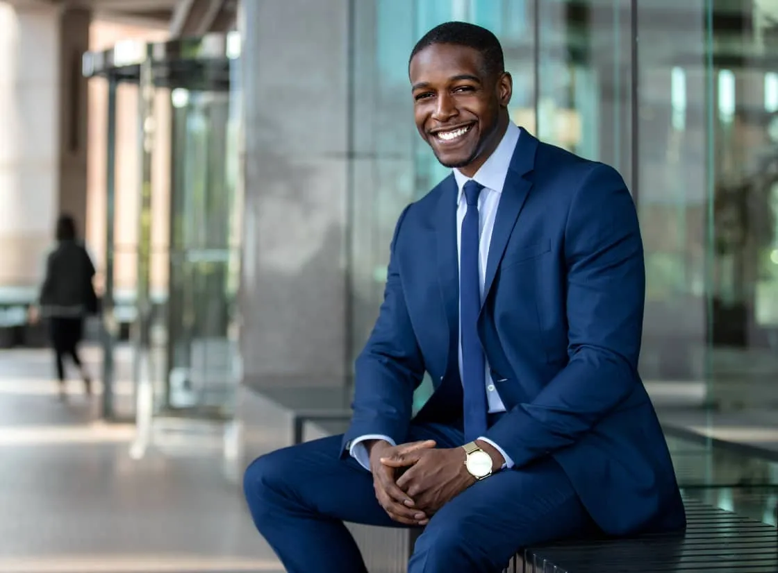
&
STEWARDSHIP
ENTREPRENEURSHIP
3 August 2024
Ikageng SDA Church
Presented by
DR HAJO MORALLANE

Slide 2



Table of contents
The Bible on Stewardship
What is Entrepreneurship?
How to be an enterprising
Steward of the Lord
How to be an enterprising
Steward of the Lord

Slide 3
The Bible on Stewardship

Slide 4




Biblical stewardship refers to the responsible management of resources, talents and time entrusted to us by God. It involves:
Managing God’s resources with integrity & wisdom
Being accountable for our actions & decisions
Using resources for God’s purposes & glory
Recognising God’s ownership & our role as managers

Slide 5


What Stewardship is not
OWNERSHIP
We don’t own resources, we manage them for God
HOARDING
Stewardship involves using resources, not accumulating them
WASTEFULNESS
Stewardship requires responsible use, not squandering resources

Slide 6

Benefits of Good Stewardship
Honours God
Brings blessings & prosperity
Demonstrates faith & trust in God
Encourages generosity & sharing
Fosters accountability & responsibility
Glorifies God through wise management

Slide 7

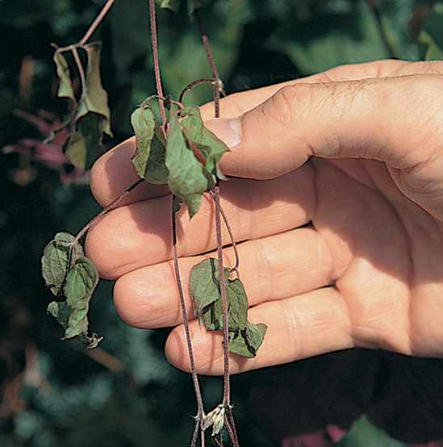
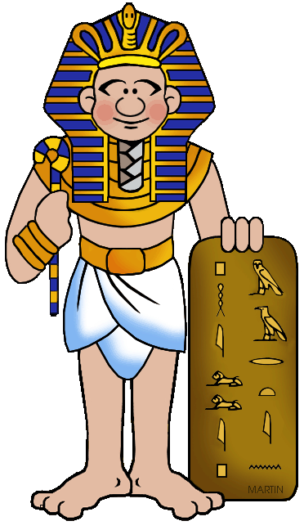

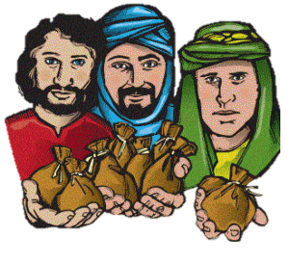

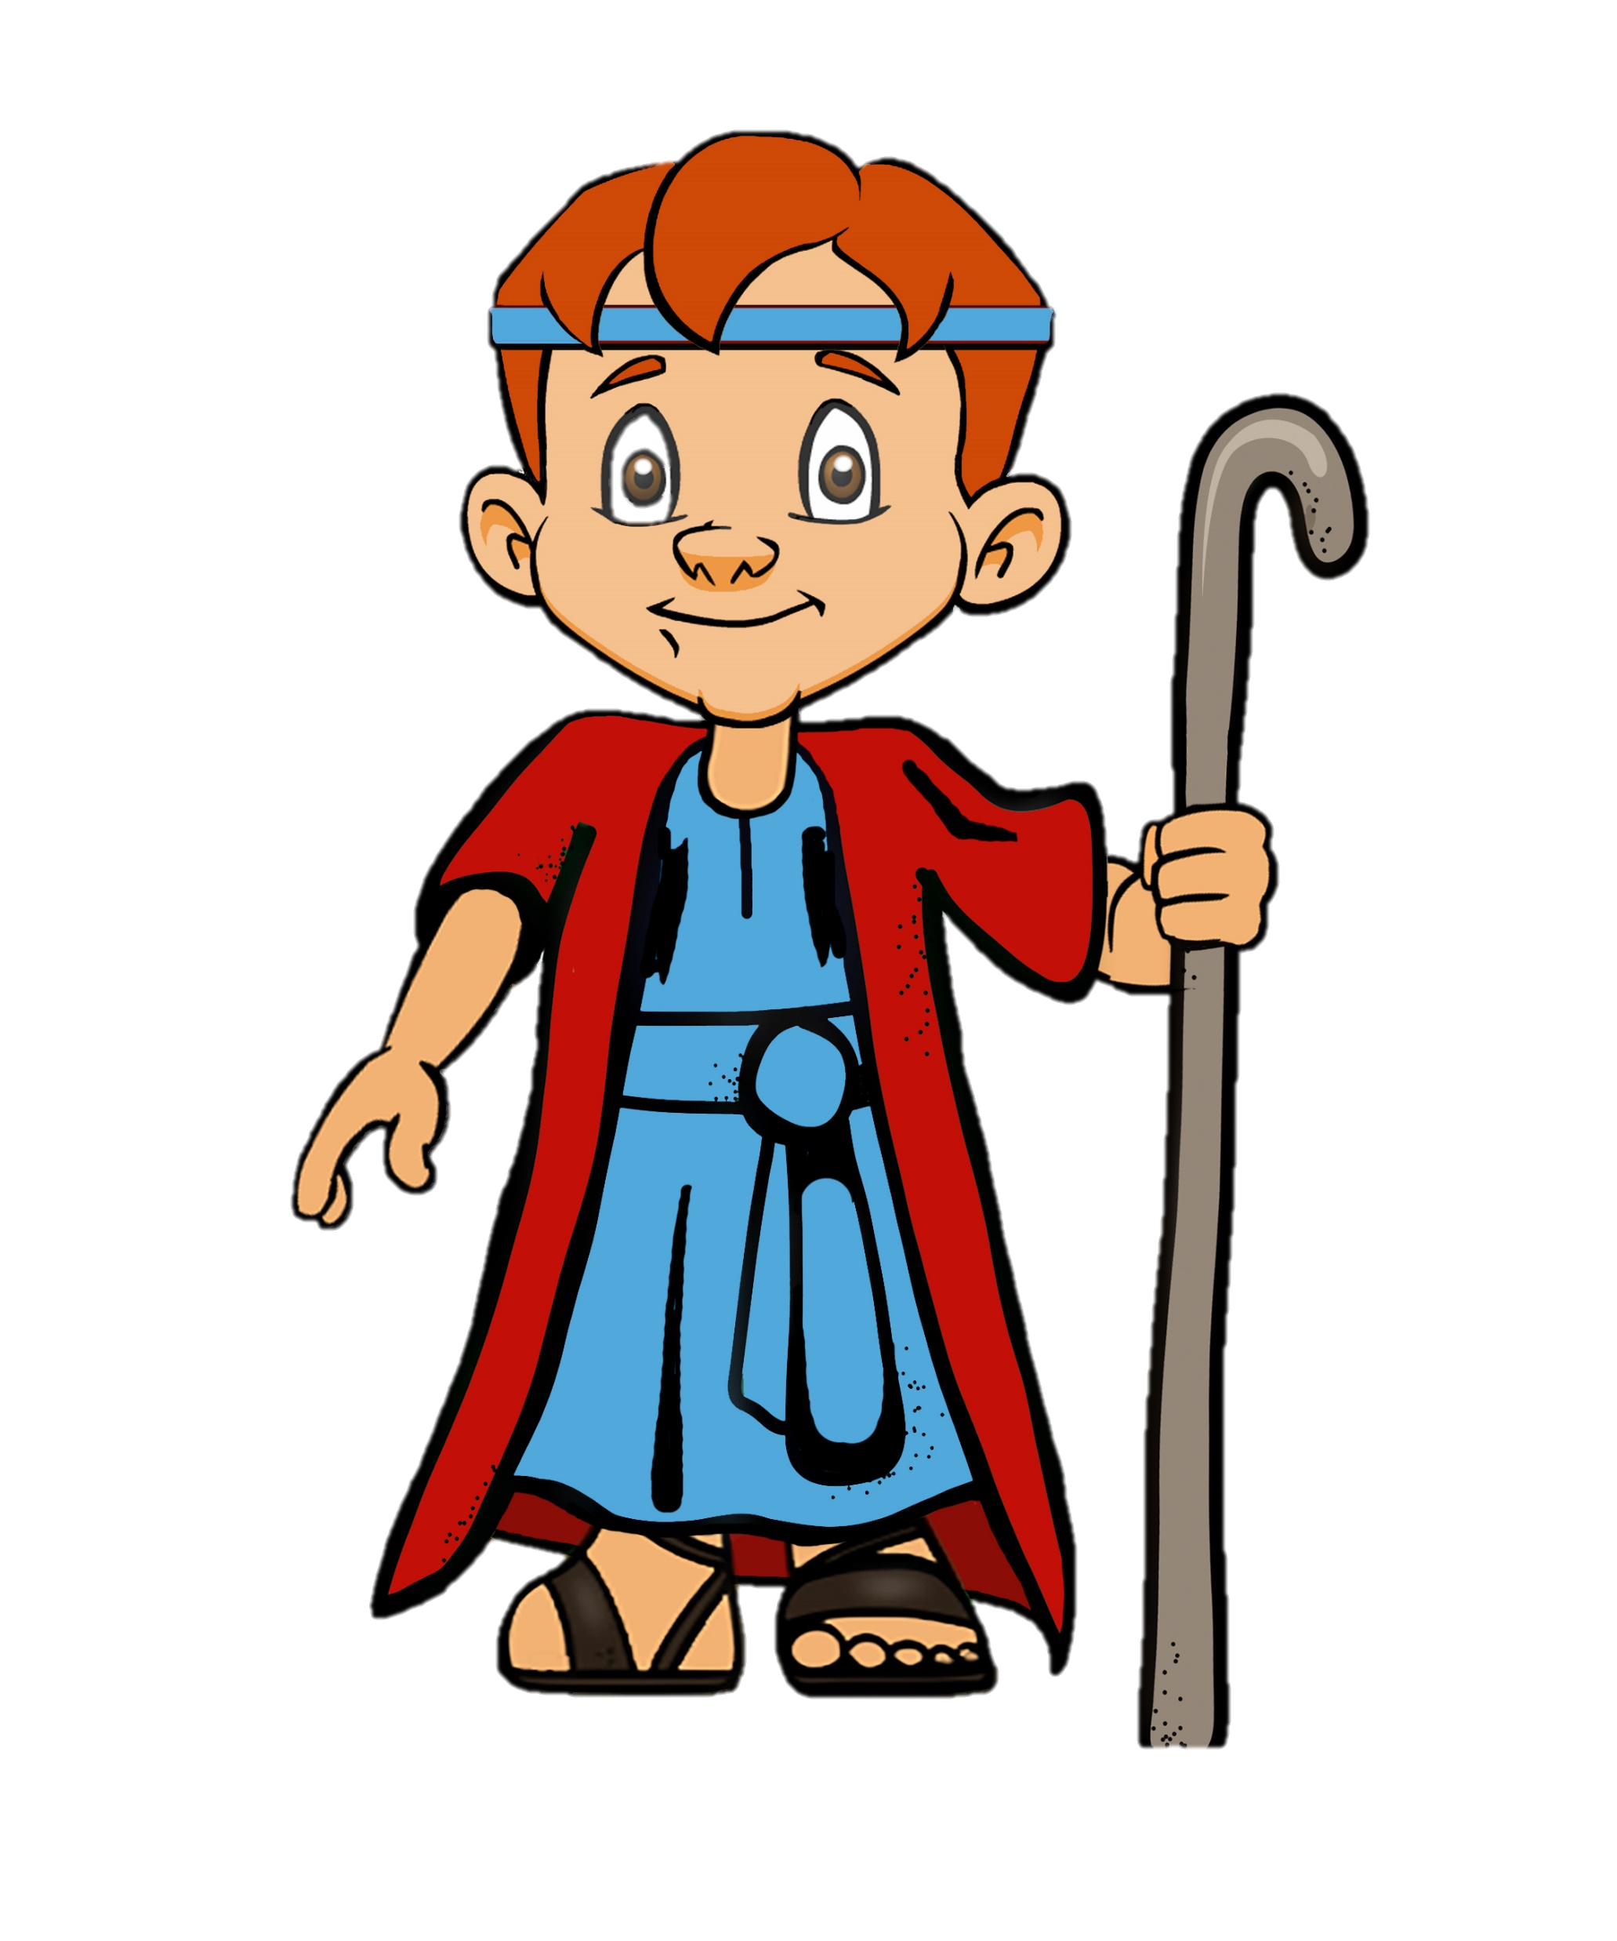
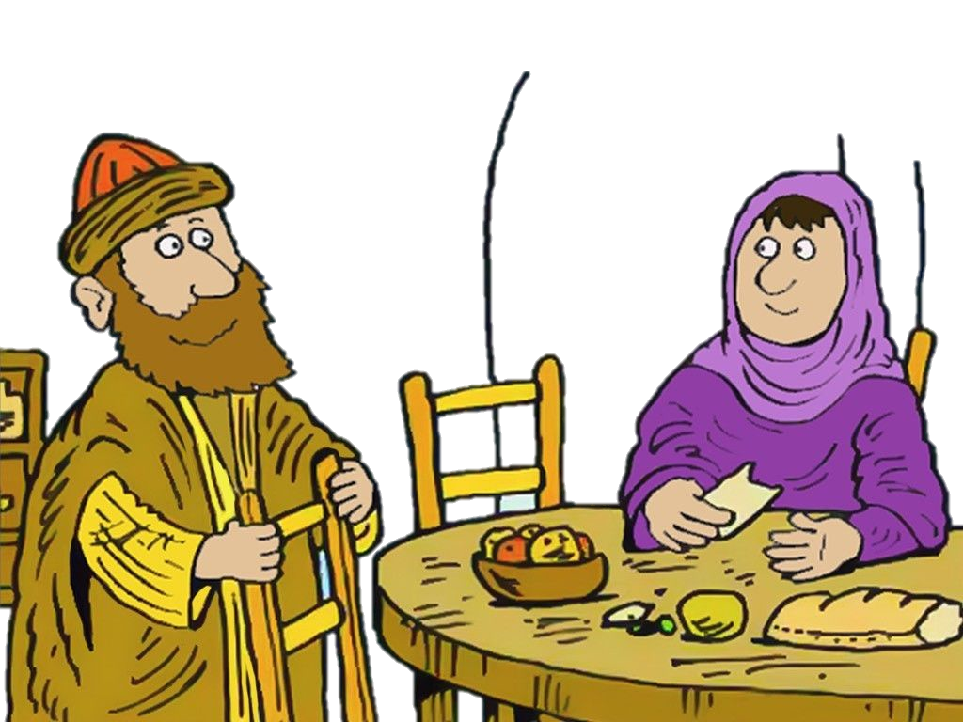
GOOD
BAD
Stewardship
Stewardship
Joseph (Gen 41)
Managed Egypt’s resources, saving the country from famine
The Unfaithful Steward (Luke 16:1-13)
Mismanaged resources leading to loss and shame
The Talents Buried (Matt 25:14-30)
Failed to use resources, leading to judgement
The Wise Virgins (Matt 25:1-13)
Prepared and managed resources wisely
Ananias & Sapphira (Acts 5:1-11)
Hoarded resources, lying about their stewardship
David (1 Sam 23:1-12)
Led and protected Israel, using resources to serve God’s people

Slide 8

Key principles
PSALM 24:1
Recognise God’s ownership
PROVERBS 10:9
Manage resources with integrity
MATTHEW 6:33
Use resources for God’s purposes
ROMANS 14:12
Be accountable
1 COR 9:6-7
Practice
generosity
By understanding and applying these principles, we can become good stewards of the resources God has entrusted to us

Slide 9
What is Entrepreneurship?

Slide 10







Entrepreneurship is the process of designing, launching, and running a business or enterprise, often to earn a profit. It involves:
Continuous learning
Identifying opportunities
Adaptability & Resilience
Innovating & creating
Risk-taking
Leadership & Vision
Resource management

Slide 11

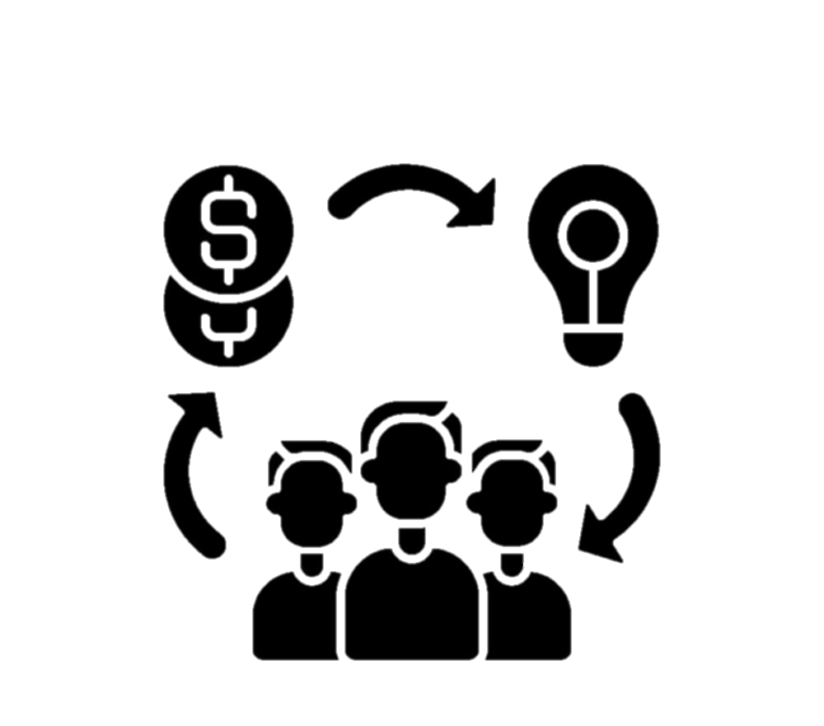



Entrepreneurship can manifest in many forms
Small Business Ownership
Startup Founding
Social Entrepreneurship
Intrapreneurship (entrepreneurial thinking within an existing organisation)
Freelancing or solo entrepreneurship

Slide 12






Entrepreneurship traits
Adaptability
01
Passion
07
02
Strategic thinking
Entrepreneurship drives economic growth, innovation, and job creation, making it a vital component of modern economies
Creativity
06
03
Resourcefulness
Strong work ethic
05
04
Resilience

Slide 13
The Bible Stewardship &
Entrepreneurship

Slide 14





Entrepreneurship & Adventist Stewardship share common values
Long-term focus
Resource Management
Faith
Innovation
Stewardship
Service
Integrity

Slide 15
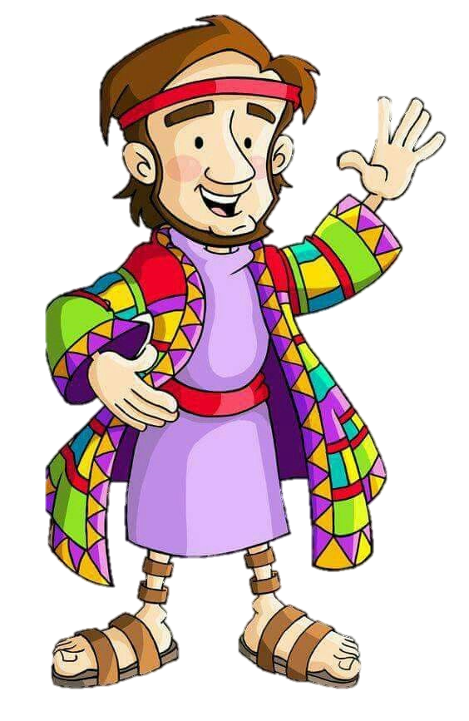
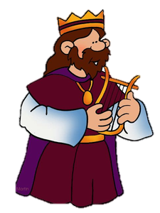
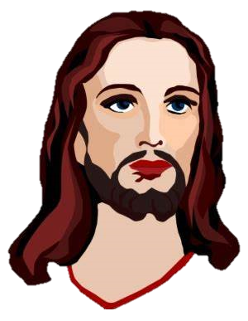

JOSEPH
Genesis 41
Demonstrated entrepreneurial skills by managing Egypt's resources and infrastructure
SOLOMON
Proverbs 22:29
Encouraged hard work and diligence in business
JESUS
Matthew 25:14-30
Taught about responsible stewardship through the Parable of the Talents

Slide 16



Stewardship mindset: Entrepreneurs can adopt a stewardship mindset, recognizing that their resources and talents are entrusted to them for the benefit of others.
Biblical principles inform entrepreneurial decisions: Entrepreneurs can apply biblical principles like integrity, honesty, and fairness to their business practices
Entrepreneurial skills serve God's kingdom: Entrepreneurs can use their skills to serve God's kingdom by creating jobs, providing for their families, and giving to their communities.
By connecting Bible Stewardship and Entrepreneurship, individuals can integrate their faith and work, leading to a more purposeful and impactful entrepreneurial journey

Slide 17
By connecting Bible Stewardship and Entrepreneurship, individuals can integrate their faith and work, leading to a more purposeful and impactful entrepreneurial journey

Slide 18




A great example of an entrepreneur in the Bible is Lydia, a purple dye merchant who demonstrated good stewardship in the following ways
Business ownership
Hospitality & generosity
Leadership & influence
Good stewardship

Slide 19
Lydia's entrepreneurial spirit and good stewardship led to:
A successful and profitable business
A positive impact on her community
Support for the spread of Christianity
A lasting legacy as a faithful and generous leader

Slide 20



Slide 21
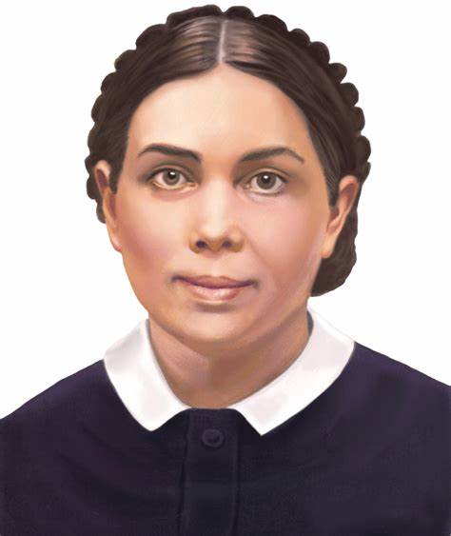

Ellen G. White, a prominent Seventh-Day Adventist author and leader, wrote about Lydia's role as an entrepreneur and steward of the Lord in her book "Acts of the Apostles"
Lydia was a seller of purple, and her business brought her into contact with people of various nations." (Acts of the Apostles, p. 144)
She was a woman of ability and means, and her influence was wide-spread." (Ibid.)
Lydia’s highlights
Business acumen & influence
Lydia's heart was open to the truth, and she was eager to learn." (Ibid.)
Openness to spiritual truth
She was a true convert, and her conversion was a testimony to the power of the gospel." (Ibid.)
Conversion & testimony
Lydia's home became a center of missionary work, and many were brought to the knowledge of the truth through her efforts." (Ibid., p. 145)
Hospitality & missionary work
Notes:
White emphasizes Lydia's role as a steward of the Lord, using her resources and influence to further the gospel message. She presents Lydia as a positive example of a Christian entrepreneur and steward, demonstrating how business and faith can be integrated to serve God and others.

Slide 22
How to be an enterprising
Steward of the Lord

Slide 23
To be an enterprising steward of the Lord, consider the following principles:
Recognise God’s ownership
Manage resources wisely
Seek divine guidance
Prioritize kingdom impact
Use your gifts and talents
Build relationships & partnerships
Be innovative and creative
Practice generosity & sharing
Take calculated risks
Stay accountable & humble
By embracing these principles, you'll become an enterprising steward who honors God and makes a positive impact in the world

Slide 24
